Slide 1
Special Topics in Database
Hyuk-ki Lee

Slide 2
Contents
Planning
createQueryPlan
executeUpdate
The Database Server
Server Databases vs Embedded Databases
Client-Server Communication
Implementing the Remote Interfaces
Implementing the JDBC Interfaces

Slide 3
Contents
Planning
createQueryPlan
executeUpdate
The Database Server
Server Databases vs Embedded Databases
Client-Server Communication
Implementing the Remote Interfaces
Implementing the JDBC Interfaces

Slide 4
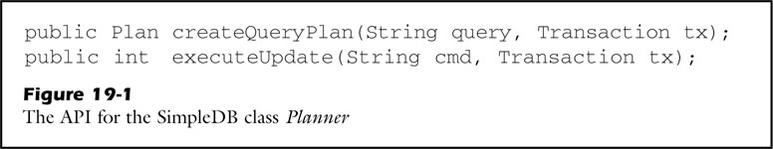
SimpleDB planner
Class Planner
createQueryPlan
Create and return a plan for the input query string
executeUpdate
Execute command string, and return the number of affected records

Slide 5
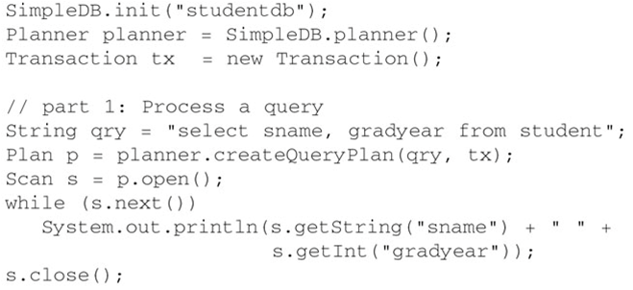

Planner example - createQueryPlan

Slide 6
Planner step - createQueryPlan
Parse SQL
Verify SQL
Create plan
Return the plan

Slide 7

Planner class - createQueryPlan
SimpleDB does not perform any explicit verification
1. Parse
3. Create plan
4. Return plan

Slide 8
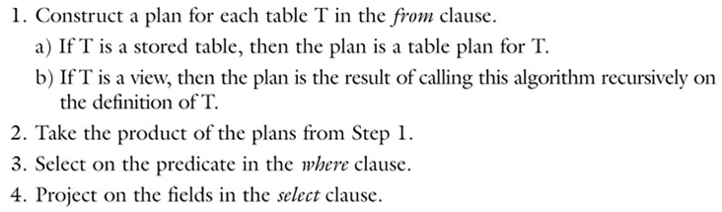
Query planning step

Slide 9
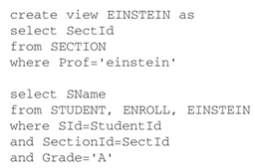
Query planning – example query

Slide 10
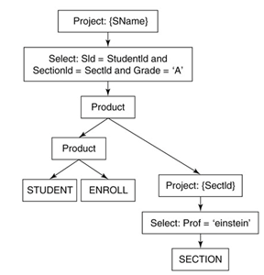
Query planning – example query tree
4. project
3. select
2. product
1. (b) The tree for the view
1. (a) Table plan

Slide 11
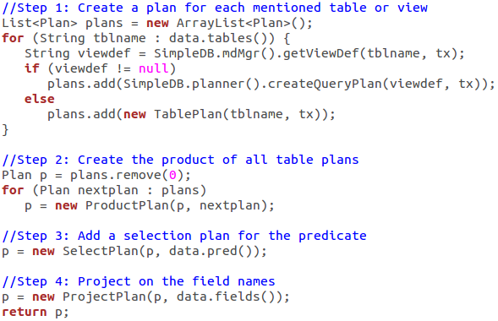
Query planning - BasicQueryPlanner

Slide 12
Query planning - BasicQueryPlanner
SimpleDB implemented only three relational algebra operators product, select, project
Standard SQL require other relational algebra
Semijoin, antijoin
Groupby
Extend
Outerjoin
Union
Sort
Etc…

Slide 13
Query Planning - Advance
The semantics of an SQL query requires that the operators appear in a particular order in the query tree
Sort – union – project – extend – select, semijoin, antijoin – outerjoin – product, join
In order for SimpleDB to be able to generate extend query tree, its parser needs to be extended

Slide 14
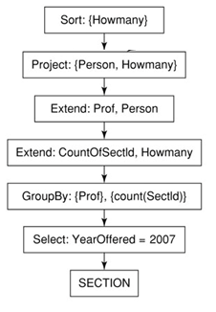
Query Planning - Advance
Select Prof as Person, count(SectId) as Howmany from SECTION where YearOffered=2007 group by Prof order by Howmany

Slide 15
Contents
Planning
createQueryPlan
executeUpdate
The Database Server
Server Databases vs Embedded Databases
Client-Server Communication
Implementing the Remote Interfaces
Implementing the JDBC Interfaces

Slide 16

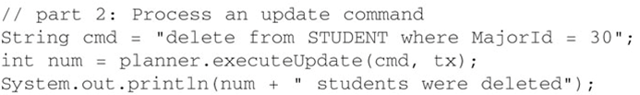
Planner example - executeUpdate

Slide 17
Planner step - executeUpdate
Parse SQL
Verify SQL
Create plan
Execute the plan
delete & modify
Insert
Create table, view and index

Slide 18
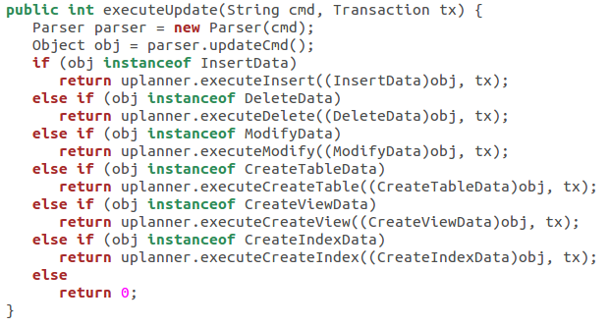
Planner class - executeUpdate
1. Parse
Create&Execute
Return value is count

Slide 19
Update planning step – delete, modify
Construct a plan for table T
Select on the predicate in the where clause
Update scan on the select plan
Delete or modify records

Slide 20
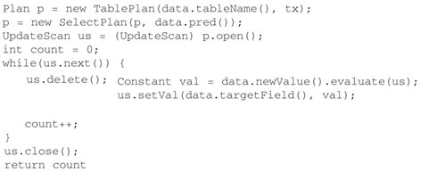
Update planning class – delete, modify
1. Construct plan
2. Select
3. Scan
4.(a) Delete
4.(b) Modify

Slide 21
Update planning step – insert
Construct a plan for table T
Table scan
Insert a new record into the scan
Modify the value of each specified field of the record

Slide 22
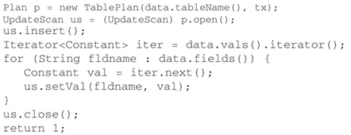
Update planning class – insert
1. Construct plan
2. Scan
3. Insert
4. Modify

Slide 23
Update planning step – create
Do not accessing any data records
Don’t require a scan
Simply call the metadata methods
createTable
createView
createIndex

Slide 24
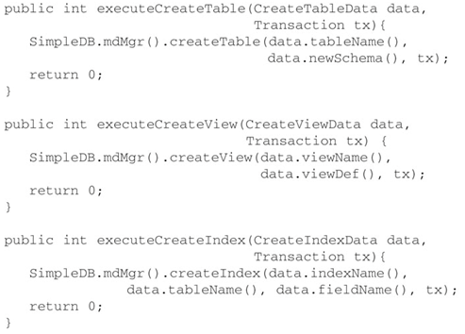
Update planning class – create

Slide 25
Contents
Planning
createQueryPlan
executeUpdate
The Database Server
Server Databases vs Embedded Databases
Client-Server Communication
Implementing the Remote Interfaces
Implementing the JDBC Interfaces

Slide 26
Server Databases
It can access the database indirectly, via a server
Calls a driver to establish a connection
Accesses the database by sending SQL statements to the server
Server executes each statement on the program’s behalf and returns the results.

Slide 27
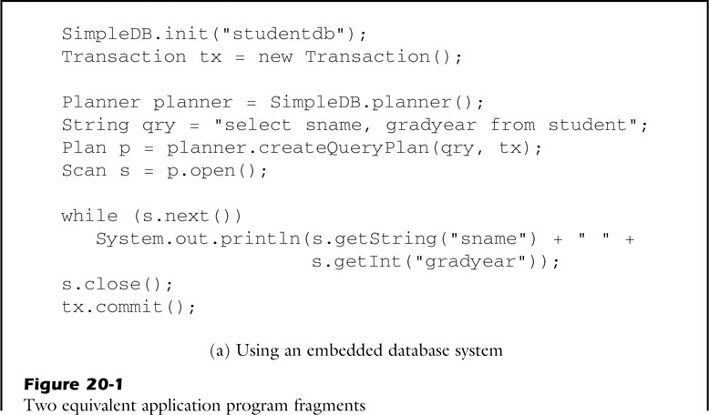
Embedded Databases
An application program embed the database system if it calls the system’s methods directly
Can be customizable
Cannot share its database with other programs

Slide 28
Architecture of SimpleDB
Client
Server
Remote
Planner
Record
Metadata
Parser
Query
Transaction
Buffer
Log
File

Slide 29
Architecture of SimpleDB
Client
Server
Remote
Planner
Record
Metadata
Parser
Query
Transaction
Buffer
Log
File

Slide 30
Contents
Planning
createQueryPlan
executeUpdate
The Database Server
Server Databases vs Embedded Databases
Client-Server Communication
Implementing the Remote Interfaces
Implementing the JDBC Interfaces

Slide 31
Client-Server Communication
Remote Method Invocation(RMI)
Performs the object-oriented equivalent of remote procedure calls (RPC)
Supports for direct transfer of serialized Java classes
In order to use RMI, a system defines one or more interfaces that extend the Java interface Remote (Remote Interface). Each remote interface always has two implementing classes: A stub and a remote interface implementation
Stub – whose objects live on the client
Remote interface implementation – whose objects live on the server
Notes:
In short, It makes that a remote method is called by the client(using the stub object) but executed on the server(using the remote implementation object).
SimpleDB implements client-server communication via the Java Remote Method Invocation(RMI) mechanism.
In order to use RMI, a system defines one or more interfaces that extend the Java interface Remote.
Each remote interface always has two implementing classes: A stub and a remote interface implementation.

Slide 32
Remote Method Invocation(RMI)
RMI Process
The client calls a method from a stub object
The method call is sent across the network to the server
The method call is executed there by remote implementation object
The result is sent back to the stub object on the client.

Slide 33
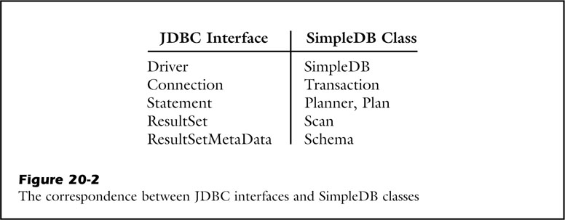
Remote interfaces of SimpleDB
SimpleDB defines 5 remote interfaces
RemoteDriver
RemoteConnection
RemoteStatement
RemoteResultSet
RemoteMetaData
These remote interfaces mirror their corresponding JDBC interfaces, with two differences:
They only implement the basic JDBC methods
They throw a RemoteException(as required by RMI) instead of an SQLException(as required by JDBC)

Slide 34
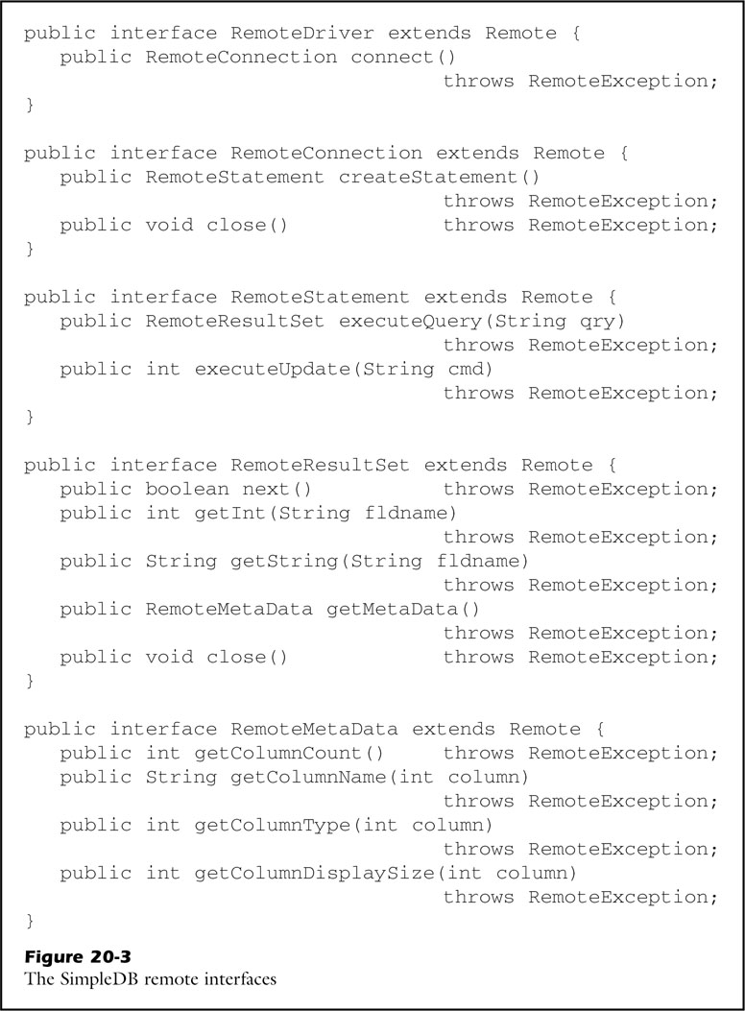
Remote interfaces of SimpleDB - Methods

Slide 35
RMI Registry
How does a client get its first stub? RMI solves this problem by RMI registry.
Usage of RMI registry
A server publishes stub objects in the RMI registry
Clients retrieve stub objects from the RMI registry

Slide 36


How to use RMI Registry
The Server publishes only one object, RemoteDriver
Creates a stub for the remote implementation object d
Makes it available to clients under the name “simpledb”
A client can request a stub from the registry by calling the method Naming.lookup

Slide 37
Contents
Planning
createQueryPlan
executeUpdate
The Database Server
Server Databases vs Embedded Databases
Client-Server Communication
Implementing the Remote Interfaces
Implementing the JDBC Interfaces

Slide 38
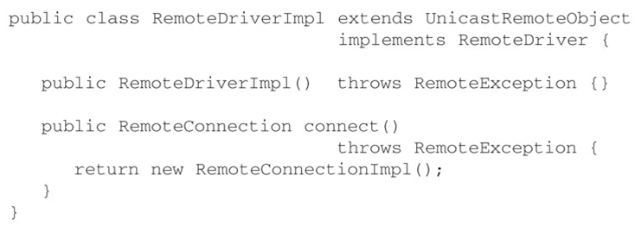
Implementing the Remote Interfaces - RemoteDriverImpl
Notes:
서버만 고려함
심플디비서버켤때 한번호출 클라이언트는 신경X

Slide 39
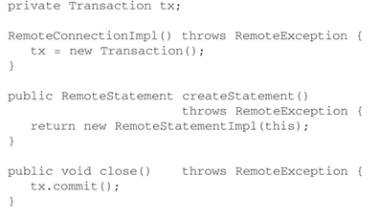
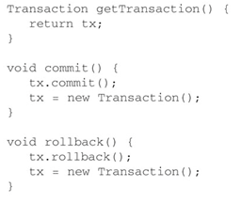
Implementing the Remote Interfaces - RemoteConnectionImpl
Client-side
Server-side
Notes:
서버-클라간연결
오른쪽꺼는 서버만씀

Slide 40
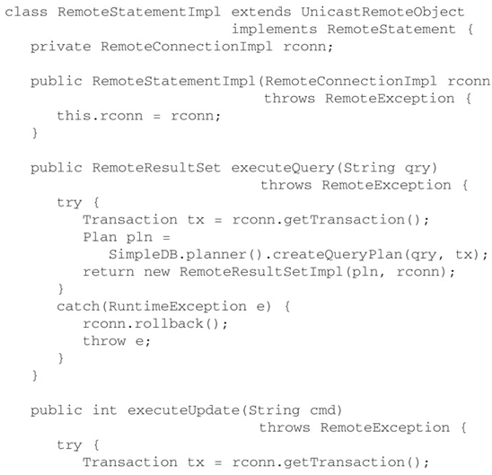
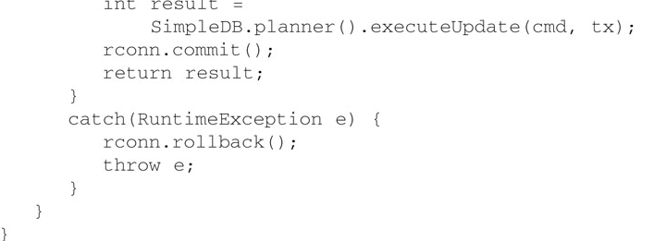
Implementing the Remote Interfaces - RemoteStatementImpl
Notes:
플래닝할때 한거 처리하는거

Slide 41
Implementing the Remote Interfaces - RemoteResultSetImpl
Notes:
플래닝하고 나온 결과 세트

Slide 42
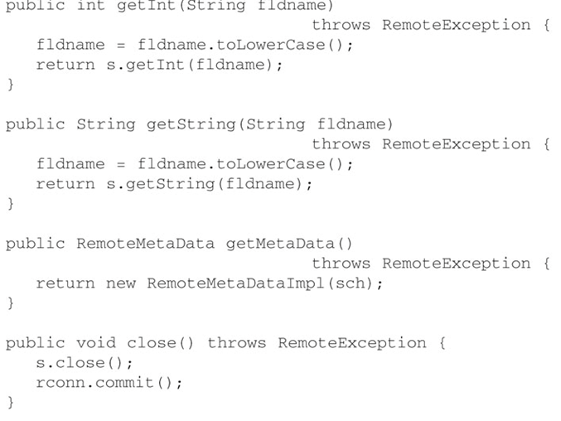
Implementing the Remote Interfaces - RemoteResultSetImpl
Notes:
플래닝하고 나온 결과 세트

Slide 43
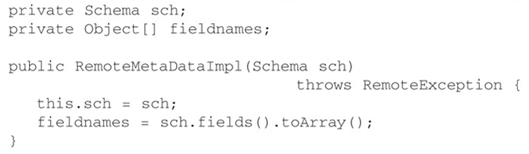
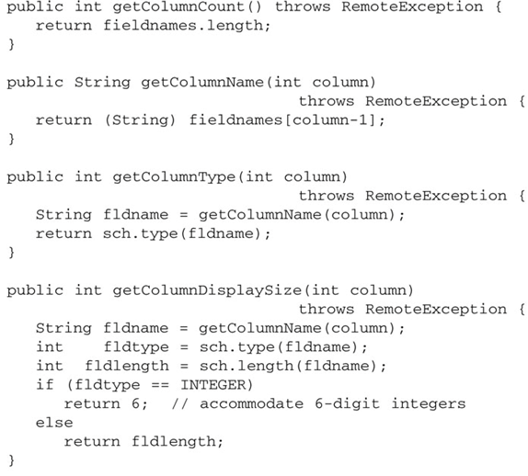
Implementing the Remote Interfaces - RemoteMetaDataImpl
KeySet->array
Notes:
플래닝하고 나온 결과 세트

Slide 44
Implementing the Remote Interfaces - RemoteMetaDataImpl
Notes:
플래닝하고 나온 결과 세트

Slide 45
Contents
Planning
createQueryPlan
executeUpdate
The Database Server
Server Databases vs Embedded Databases
Client-Server Communication
Implementing the Remote Interfaces
Implementing the JDBC Interfaces

Slide 46
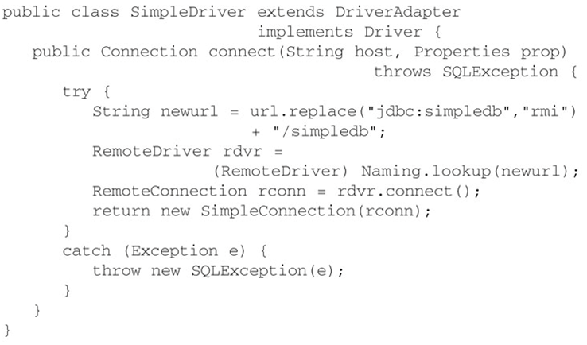
Implementing the JDBC Interfaces

Slide 47
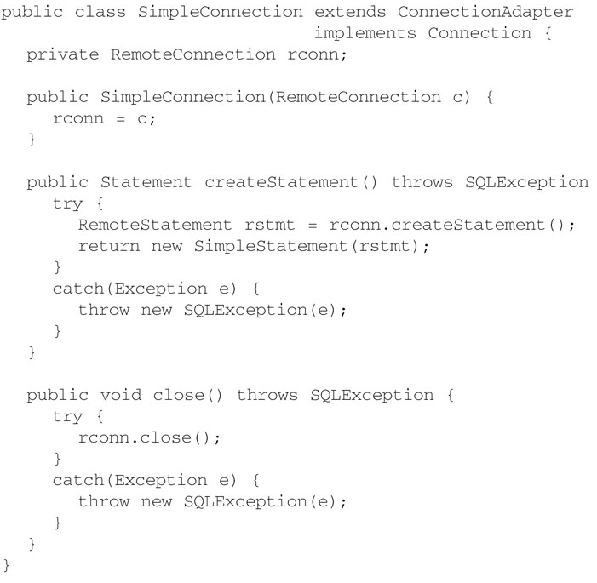
Implementing the JDBC Interfaces

Slide 48
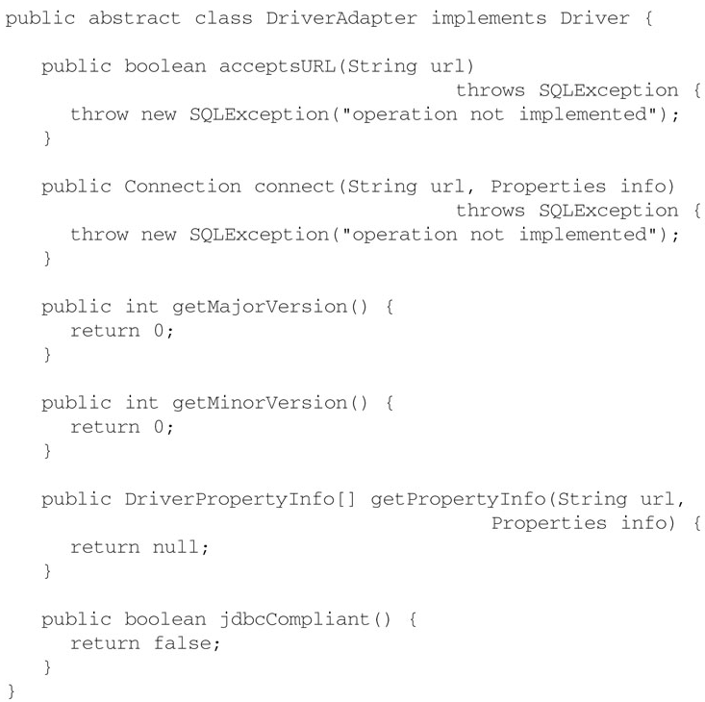
Implementing the JDBC Interfaces

